Slide 1


SALES FINANCIAL DASHBOARD
by Tabrej Patel

Slide 2
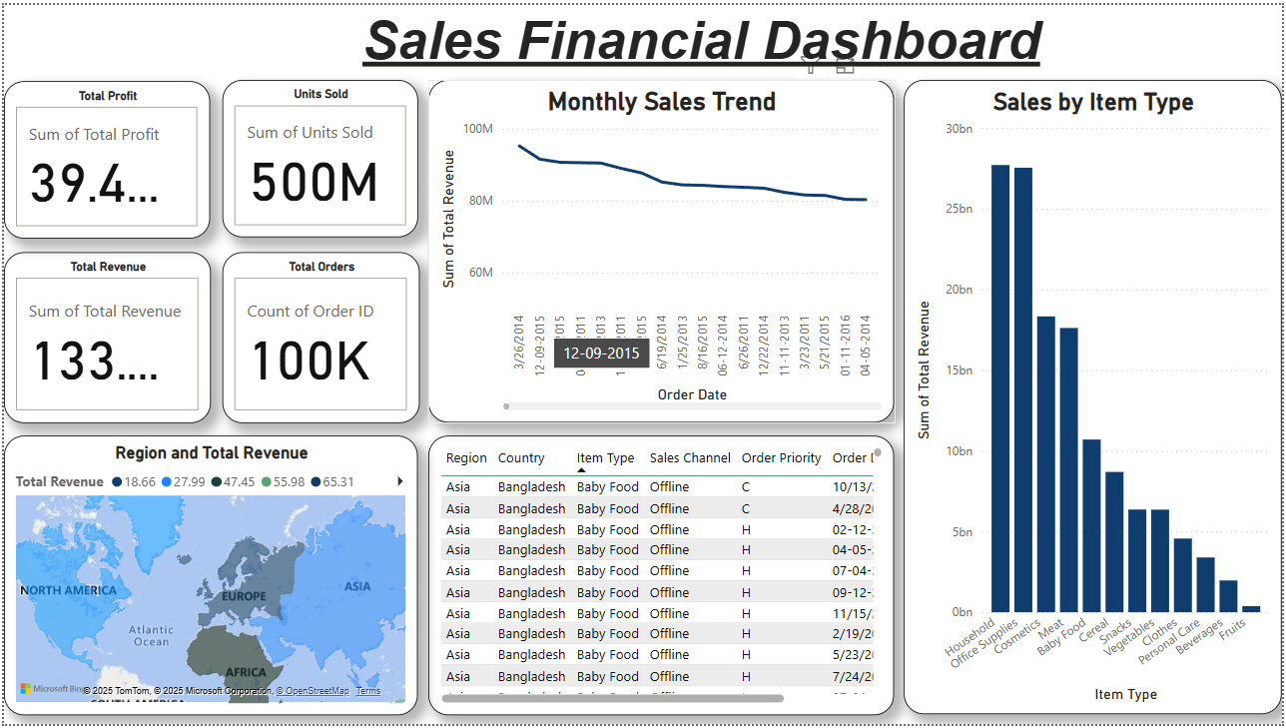

Slide 3
SUMMARY OF INSIGHTS
Sales Growth Trend: Monthly sales showed a consistent upward trend, reflecting strong business momentum.
Profit by Region: The North American region contributed the highest profit among all regions.
Top-Selling Product Categories: Household and Office Supplies emerged as the most profitable product types.
Sales Channel Performance: The Online channel achieved higher unit sales, while Offline sales had stronger profit margins.
Impact of Order Priority: High-priority orders generated higher
revenues and were fulfilled faster compared to others.

Slide 4
Thank You
For your attention

